Slide 1
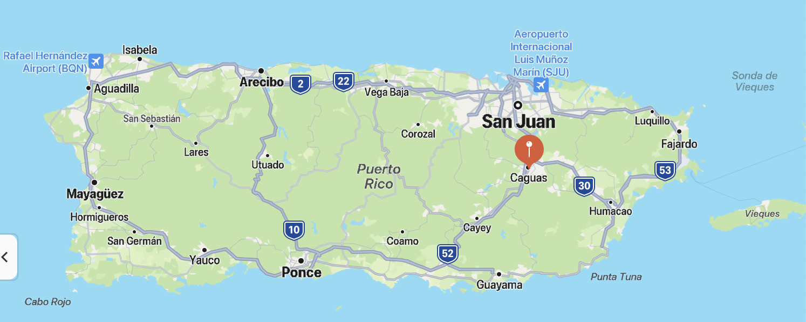
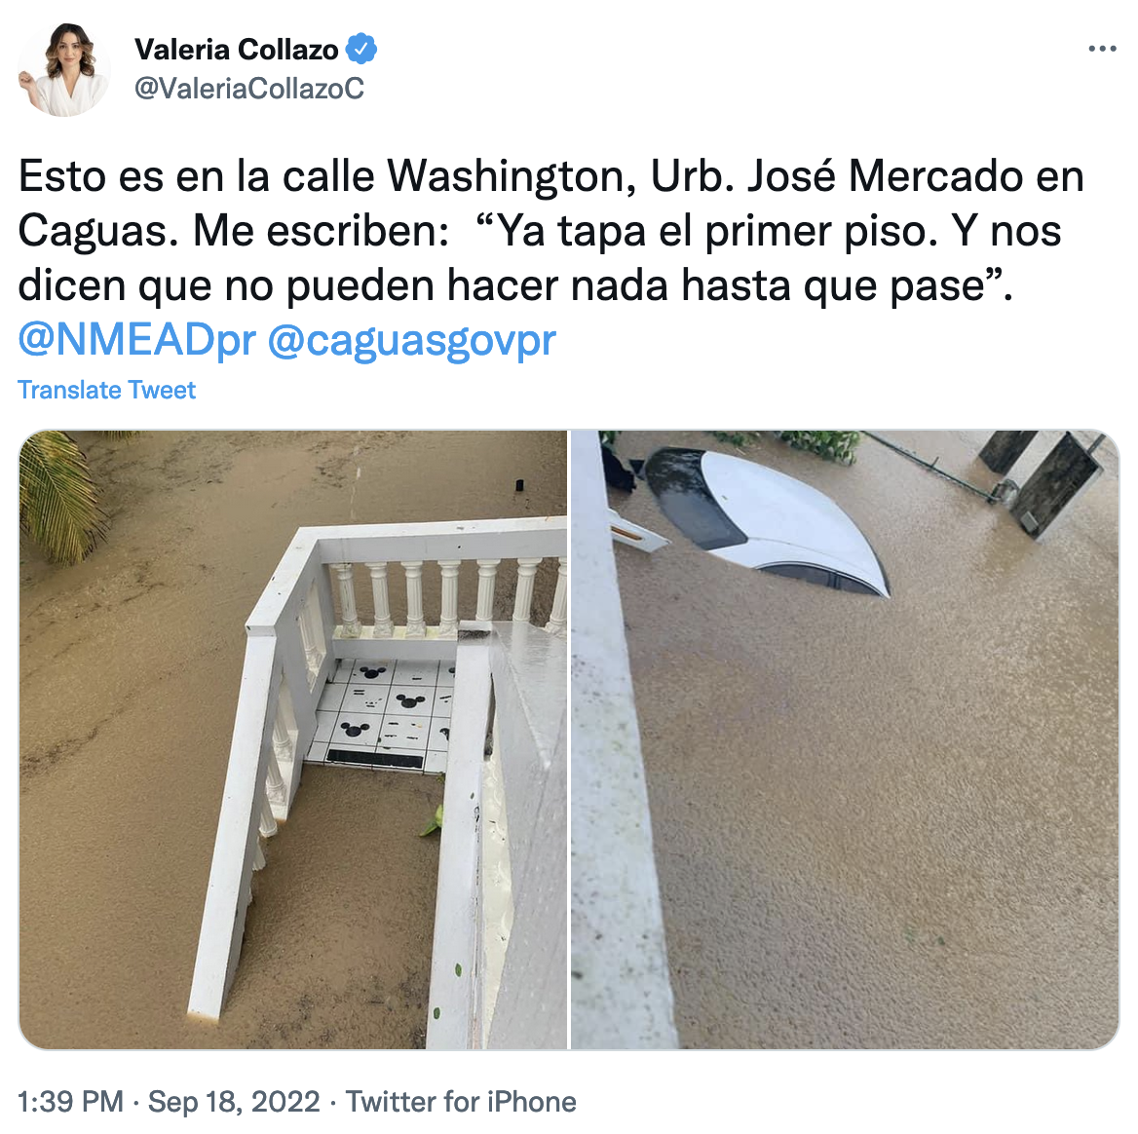
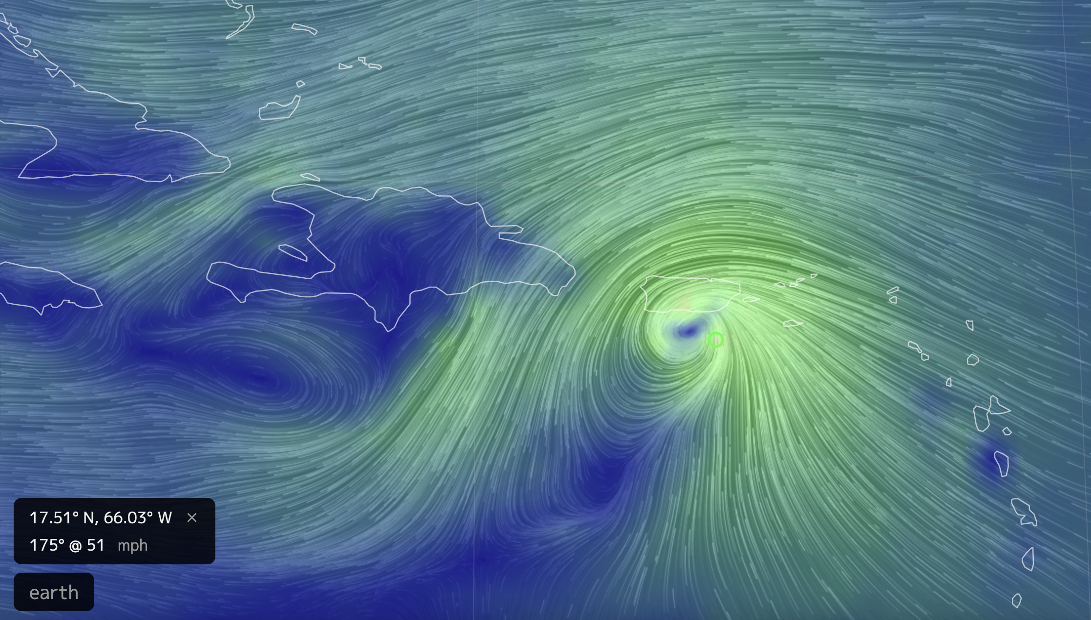
What’s happening in Puerto Rico

Slide 2
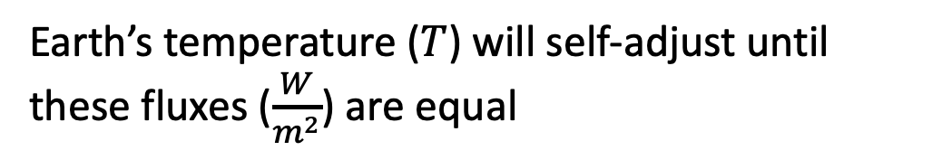
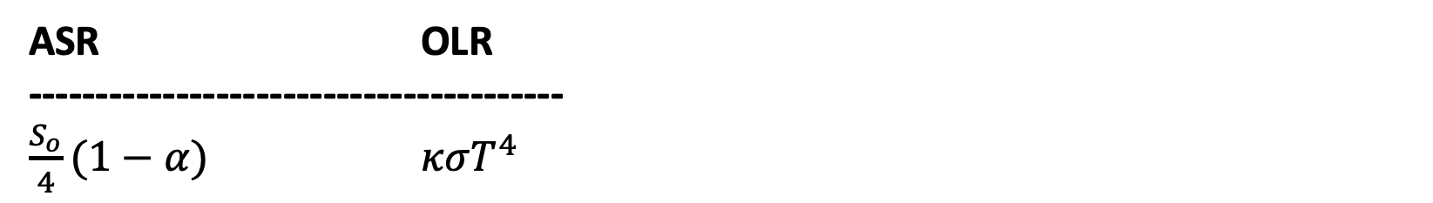
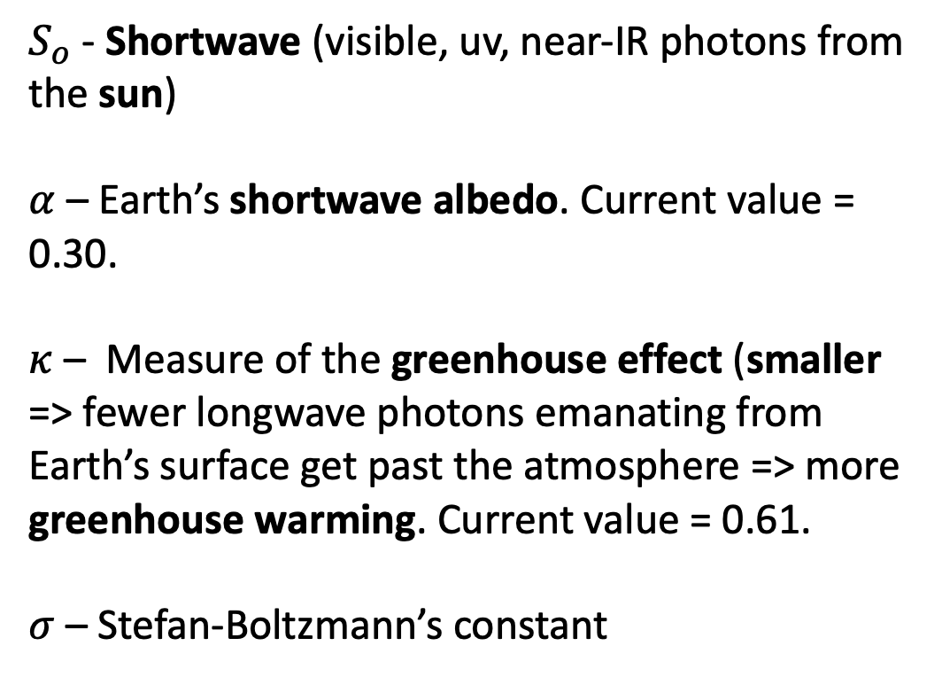
Radiative balance enactment
$S_{o}$ - Shortwave (visible, uv, near-IR photons from the sun)
$α$ – Earth’s shortwave albedo. Current value = 0.30.
$κ$ – Measure of the greenhouse effect (smaller => fewer longwave photons emanating from Earth’s surface get past the atmosphere => more greenhouse warming. Current value = 0.61.
$σ$ – Stefan-Boltzmann’s constant
ASR OLR
----------------------------------------
$\frac{S_{o}}{4}(1−α)$ $κσT^{4}$
Earth’s temperature ($T$) will self-adjust until these fluxes ($\frac{W}{m^{2}}$) are equal

Slide 3

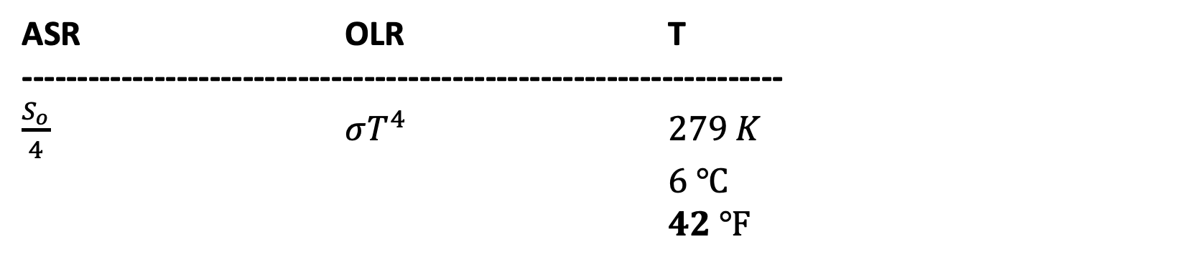
Radiative balance calculations – no albedo and no greenhouse warming
ASR OLR T
---------------------------------------------------------------------
$\frac{S_{o}}{4}$ $σT^{4}$ $279 K$
$6 ℃$
$42 ℉$
$$342\frac{W}{m^{2}}$$

Slide 4

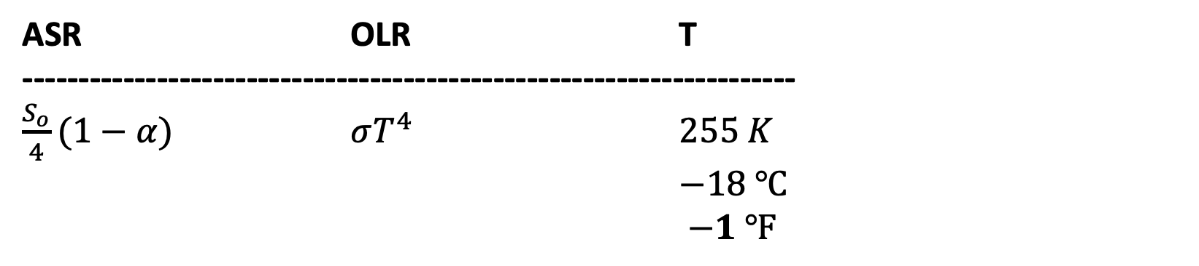
Radiative balance calculations – with albedo, but no greenhouse warming
ASR OLR T
---------------------------------------------------------------------
$\frac{S_{o}}{4}(1−α)$ $σT^{4}$ $255 K$
$−18 ℃$
$−1 ℉$
$$239\frac{W}{m^{2}}$$
Lesson: ALR went down, so temperature had to go down too

Slide 5
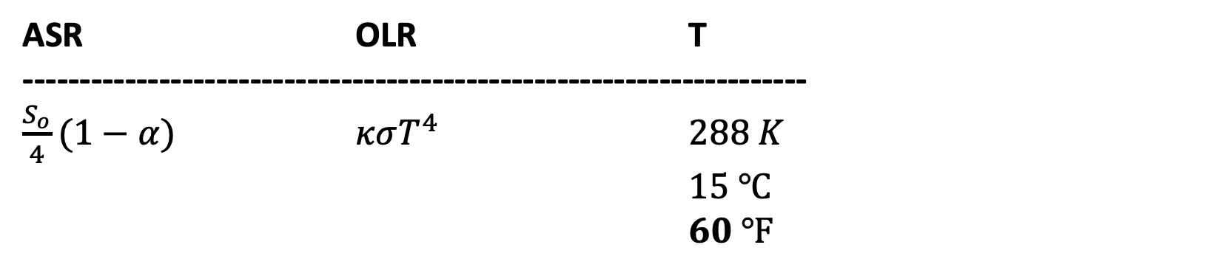
Radiative balance calculations – with albedo and greenhouse warming
ASR OLR T
---------------------------------------------------------------------
$\frac{S_{o}}{4}(1−α)$ $κσT^{4}$ $288 K$
$15 ℃$
$60 ℉$
$$239\frac{W}{m^{2}}$$

Slide 6
Radiative balance calculations – with albedo and greenhouse warming
ASR OLR T
---------------------------------------------------------------------
$\frac{S_{o}}{4}(1−α)$ $κσT^{4}$ $288 K$
$15 ℃$
$60 ℉$
$$239\frac{W}{m^{2}}$$
Lesson: OLR went down, so temperature had to go up to keep up with ASR.

